Slide 1

The New Marketing
Jennifer Zeszut
CEO, Beckon
@jenniferland

Slide 2
What is marketing?
(hint: it’s *not* selling)

Slide 3
“Selling concerns itself with the tricks and techniques of getting people to exchange their cash for your product. It is not concerned with the values that the exchange is all about. And it does not, as marketing invariably does, view the entire business process as consisting of a tightly integrated effort to discover, create, arouse, and satisfy customer needs."
--Harvard Business School's emeritus professor of marketing,
Theodore C. Levitt

Slide 4
tightly integrated effort to discover, create,
arouse, and satisfy customer needs
Customer research
Competitive intelligence
Strategic business intelligence
Product development
Customer acquisition / campaigns
Customer retention
Customer support
Community connection

Slide 5
1900
1950
2011
village marketing

Slide 6

Life in the village
Small, well-connected communities
Everyone knew each other
Word spread quickly

Slide 7
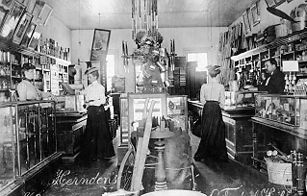
1900
Know your community, participate in your community.
What to stock? Listen to conversations
Commerce in the village

Slide 8
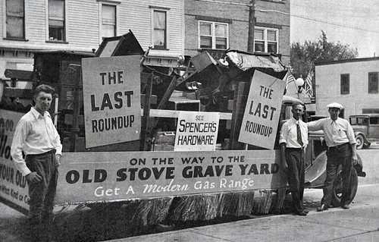
Be honest, good (nowhere to hide)
Focus on great product (not great claims)
Strength of character required to succeed
Marketing in the village

Slide 9
1900
1950
2011
mass media marketing

Slide 10
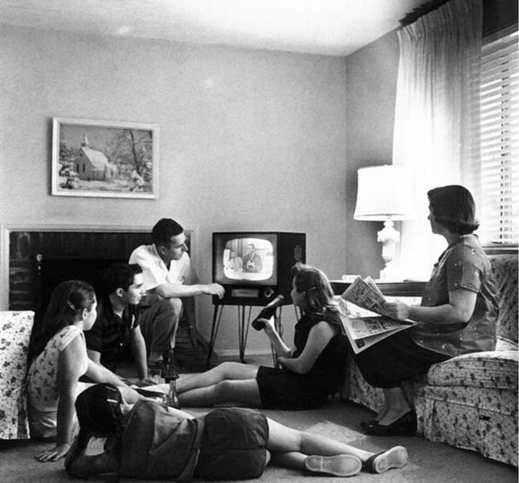
Consumers used to be such good little listeners
Limited media choices
Trust in institutions (including brands)
Consumers disconnected from each other

Slide 11
Old Marketing: “waterfall” to the extreme
Strategic business intelligence
Launch (customer acquisition)
Competitive Intelligence
Product development
Customer retention
Customer research
Customer support
The customer

Slide 12

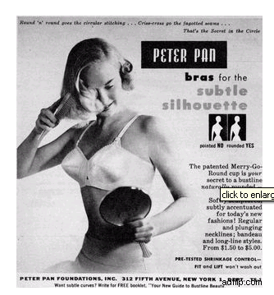

Notes:
Now who can sing the mr. clean jingle with me? Watch it – it will date you!
Don’t tease – you younger ones were totally brainwashed too – what about this one? (slinky?)

Slide 13
1900
1950
2010
global village marketing

Slide 14

1 billion+ people talking online right now, forcing companies to rethink how they listen, market, innovate.
BLOGS
TWITTER
SOCIAL NETWORKS
IMAGE-SHARING SITES
FORUMS
VIDEO-SHARING SITES
Notes:
Customers are talking – whether companies like it or not.
Every day, all across the Internet, Customers are ranting, raving.
Telling companies and eachother what they think, what they want, and how they feel.
And most importantly, they are listening to each other – they trust each other far more than they do marketing spin. So these voice no matter a lot.
<click>

Slide 15
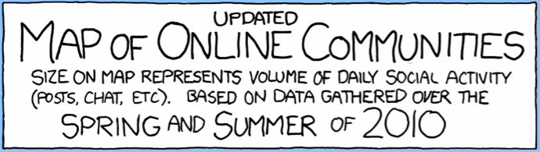
The Fire Hose of Feedback
Source: xkcd

Slide 16
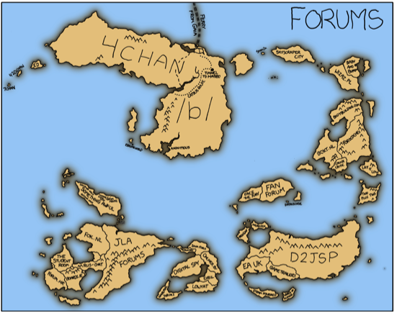
Notes:
Started by 15-year old “moot”
Discussion boards / forums mostly about anime and manga
Anonymous only posts
Lolcats and Rickrolling
Incredibly powerful community

Slide 17
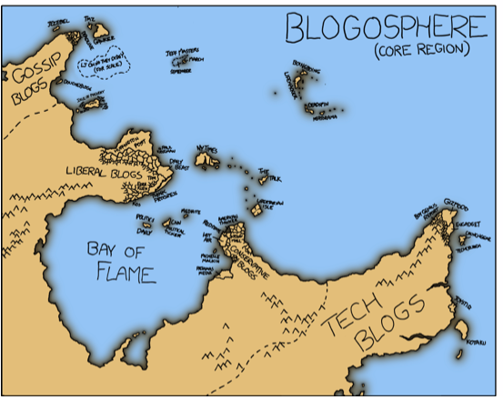

Slide 18
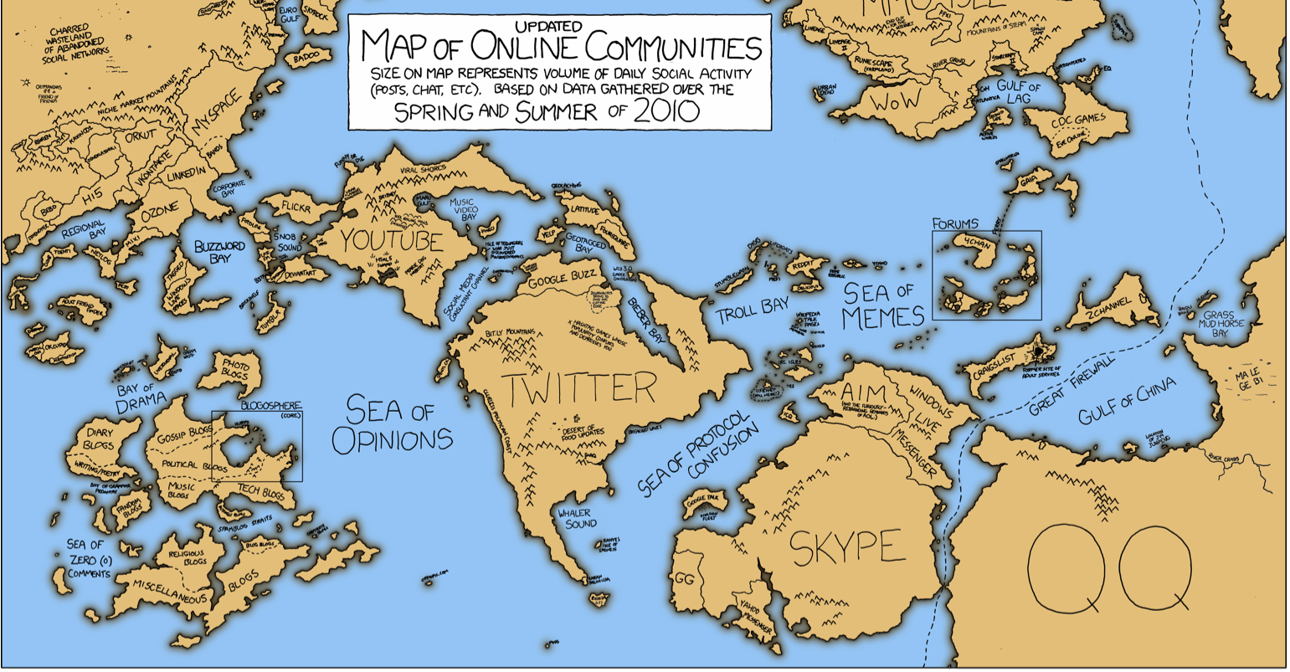

Slide 19
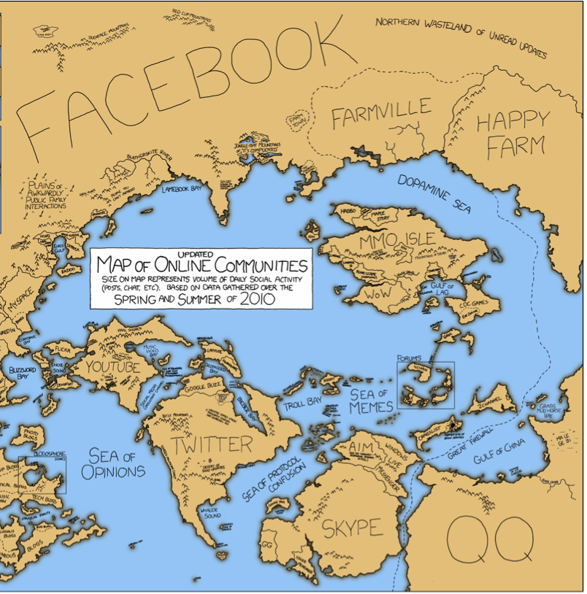
It can be a bit overwhelming

Slide 20

Enabled networks hold brands accountable
http://us.gizmodo.com/gadgets/home-entertainment/comcast-tech-falls-asleep-on-guys-couch-182440.php

Slide 21
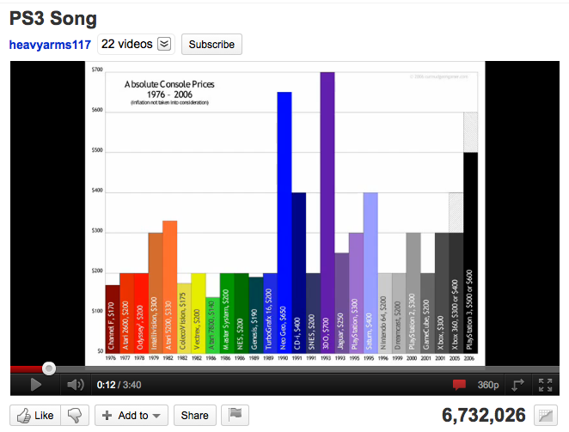
Brand Advocates are out there too
  http://www.youtube.com/watch?v=R98qC0fd_1w

Slide 22
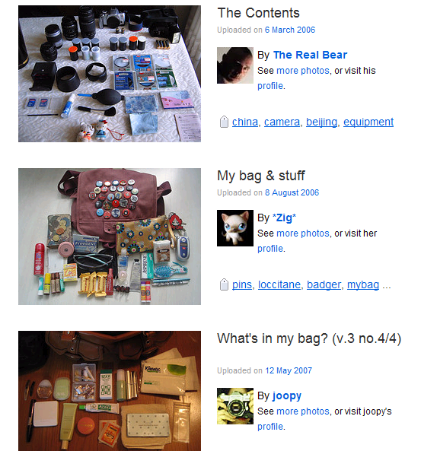
They’re telling us everything

Slide 23

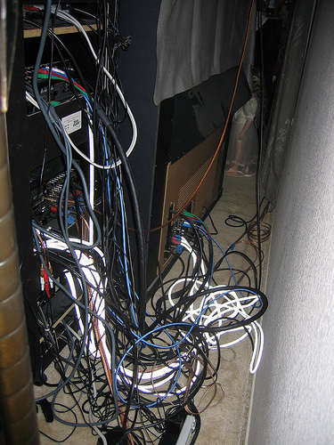
What problems need to be solved
“my ideal workspace”
“my home theater – can anyone help?”

Slide 24
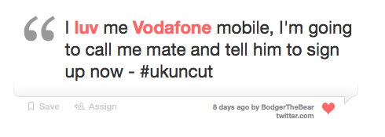
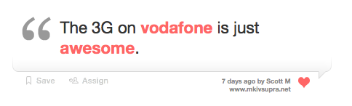
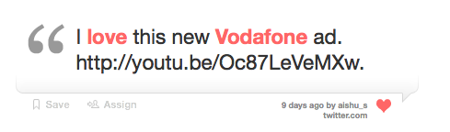

What they are loving

Slide 25
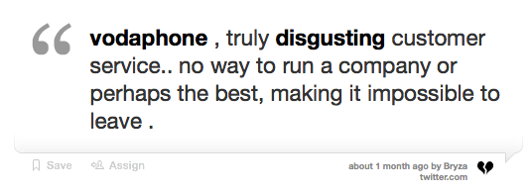
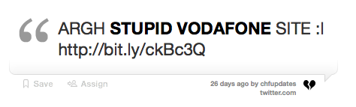
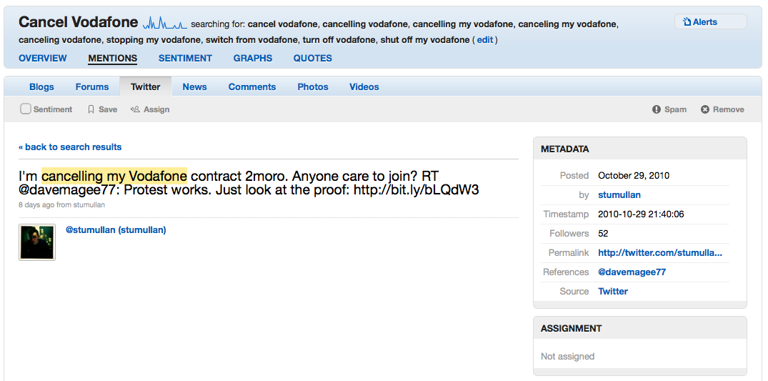
What they are hating

Slide 26

Interruption marketing is dying
Another World
As the World Turns
The Brighter Day
The Catlins
The Edge of Night
The First Hundred Years
From These Roots
The Guiding Light
Lovers and Friends / For Richer, for Poorer
Our Private World
Search for Tomorrow
Somerset
Texas
The Young and the Restless
Young Doctor Malone

Slide 27
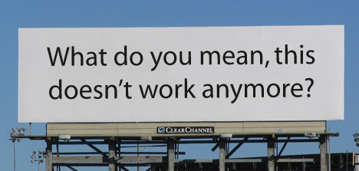

Slide 28


Slide 29
The New Rules of Marketing
Tune In. Your community is out there talking whether you like it or not -- listen up.
Stop asking and start observing. Customer insight is everywhere.
Jump In. Join the conversation, on their turf, by their rules.
Let the customer be your guide. Let them help you build better products and sell more.
Get to know a new breed of influencers. You never would have guessed who it is.
Get real-time. Watch the animals in their native habitat, 24-7. Be ready to act fast.
Be good or beware. If you dont act on the inside the way you talk on the outside – watch out.
Less spinning, more building better products. It’s all you really can control.
Start brand-building earning. You need to earn your customers attention. Think content.
Marketers, will you please step out from behind the two-way mirror.
Let your customers do the talking. They’re often far more effective than you are.

Slide 30
Old Marketing: “waterfall” to the extreme
Strategic business intelligence
Launch (customer acquisition)
Competitive Intelligence
Product development
Customer retention
Customer research
Customer support
The customer

Slide 31
Agile Marketing, Powered by Data
Community connection
Customer research
Customer support
data
data
Competitive Intelligence
data
data
The customer
data
data
data
data
data
data
data
Customer retention
data
data
data
data
Strategic business intelligence
data
Launch (customer acquisition)
Product development

Slide 32
Back to the Marketing Future

